Slide 1
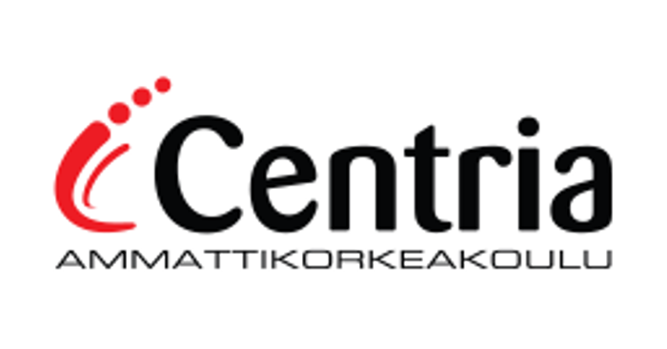
A real time application to track a farm using an object detection system.
Presented by Centria University of Applied Science Digitilisation Team

Slide 2
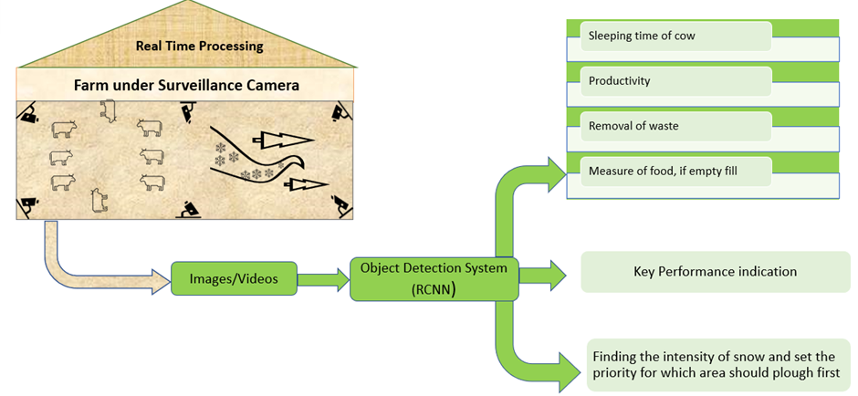
Objective of the study
A real time processing system for a farm which is under the surveillance camera

Slide 3
Background
Object detection system is used in tracking the objects.
Early signs of cattle abnormalities can be detected timely with the help of the object detection system.
For instance, tracking a ball during a football match, tracking movement of a cricket bat, tracking a person in a video all these are existing system for tracking.
With the same idea, it is possible to track and monitor a farm using object detection system.
Object tracking has a variety of uses like surveillance and security, traffic monitoring, video communication, robot vision, animation and so on.

Slide 4
Methods used
Data Collection
Data Preparation:
Data Preprocessing

Slide 5
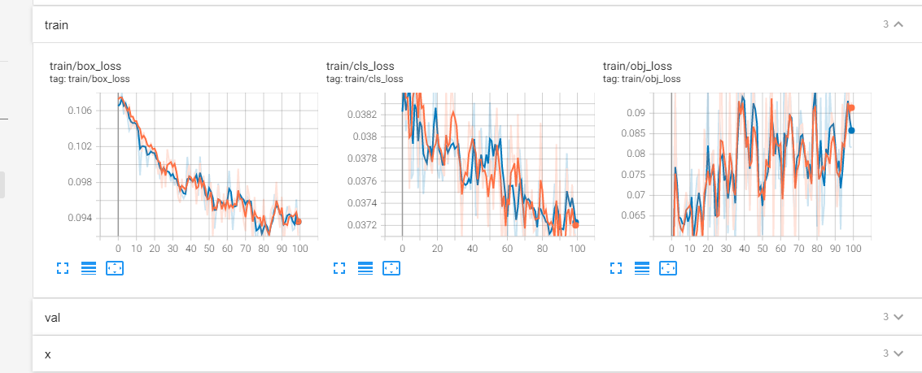
Yolo version 5
To achieve the objective of the study a comparative study done used (You only look once) YOLO-version 5
This was successfully implemented with productive results.

Slide 6
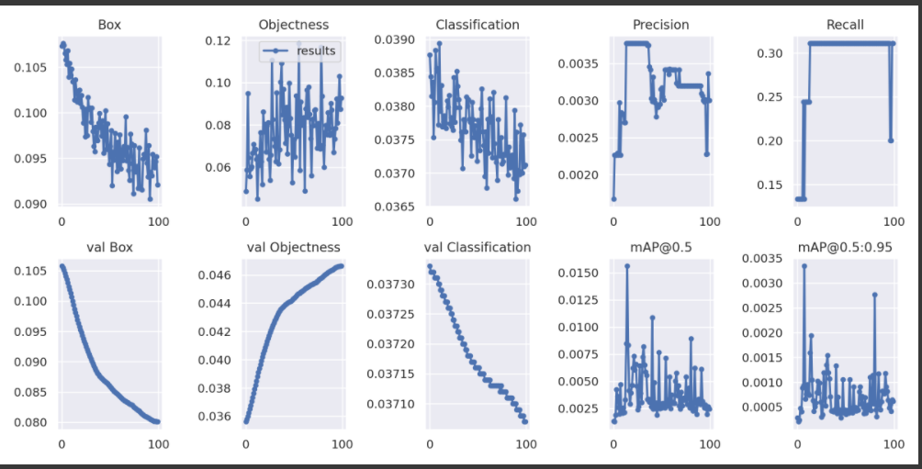

Slide 7
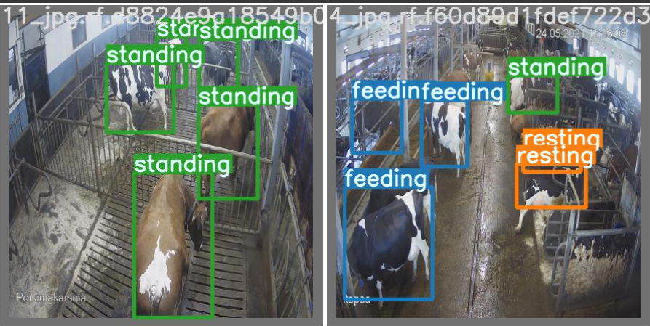

Slide 8
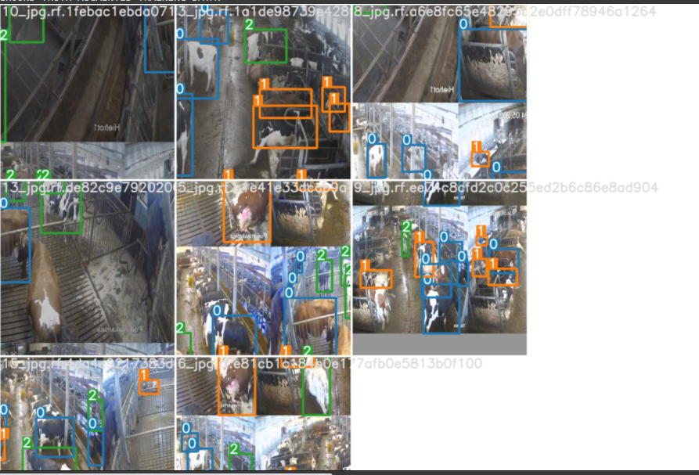

Slide 9
Study with MRCNN is undergoing

Slide 10
Conclusion

Slide 11
THANK YOU

